Slide 1
Translate -200 to 16 bit twos complement, then to hexadecimal.
200 = 128+64+8 = 0000000011001000
Complement = 1111111100110111
Add 1 = 1111111100111000
Convert to hex
1111 1111 0011 1000 = 0xFF38

Slide 2
Translate -2 to 16 bit twos complement, then to hexadecimal.
2 = 128+64+8 = 0000000000000010
Complement = 1111111111111101
Add 1 = 1111111111111110
Convert to hex
1111 1111 1111 1110 = 0xFFFE

Slide 3
Multiplication
Start
Multiplier0 = 1
1. Test Multiplier0
Multiplier0 = 0
Product
Multiplier
Multiplicand
0000 1011
0010
1a. Add multiplicand to product and place the rest in product register.
0010 1011
0001 0101
0011 0101
0001 1010
2. Shift the product register right 1 bit.
0001 1010
0000 1101
64th repetition?
No: <64 repetitions
0010 1101
0001 0110
Yes: 64 repetitions
Done
(© Morgan Kaufmann)
Notes:
OFF SCREEN
this is a version of the multiplication algorithm that requires less hardware
what's required for the product gets larger as the multiplicand shifts left [CLICK]
As the product requires more precision, [CLICK]
the multiplier requires less
so we can put them in the same register and as the multiplier shifts out, the product can shift in
We’re going to have a combined product and multiplier register. [CLICK]
We’ll put the multiplier in the lower half of the register.
we will look at the lowest bit and it's a 1 so we're going to add the multiplicand to the highest four bits of this combined register
so we add 0010 to this part [CLICK]
then we shift the whole thing to the right [CLICK]
then repeat
we look at the lowest bit, and it is a 1.
so we add 0010 to to the high part [CLICK]
and then we shift it to the right [CLICK]
now we have a zero so we don't the multiplicand [CLICK]
and shift it to the right [CLICK]
now we have a one in the least significant bit
so we add 0010 to to the upper four bits [CLICK]
and we get this result
we do one more shift [CLICK]
and that's our result
[CLICK – Next Slide]

Slide 4
Multiply 7 times 6
Iteration | Step | Multiplicand | Product|Multiplier | Action
0 | Initial values | 0111 | 00000110
1 | 1 | 0111 | 00000110 | Lowest bit of Product|Multiplier is 0, do not add multiplicand
 | 2 |  | 00000011 | Shift right
2 | 1 |  | 01110011 | Lowest bit of Product|Multiplier is 1, add multiplicand
 | 2 |  | 00111001 | Shift right
3 | 1 |  | 10101001 | Lowest bit of Product|Multiplier is 1, add multiplicand
 | 2 |  | 01010100 | Shift right
4 | 1 |  | 01010100 | Lowest bit of Product|Multiplier is 0, do not add multiplicand
 | 2 |  | 00101010 | Shift right

Slide 5
Multiply 10 times 5
Iteration | Step | Multiplicand | Product|Multiplier | Action
0 | Initial values | 1010 | 00000101
1 | 1 | 1010 | 10100101 | Lowest bit of Product|Multiplier is 1, add multiplicand
 | 2 |  | 01010010 | Shift right
2 | 1 |  | 01010010 | Lowest bit of Product|Multiplier is 0, do not add multiplicand
 | 2 |  | 00101001 | Shift right
3 | 1 |  | 11001001 | Lowest bit of Product|Multiplier is 1, add multiplicand
 | 2 |  | 01100100 | Shift right
4 | 1 |  | 01100100 | Lowest bit of Product|Multiplier is 0, do not add multiplicand
 | 2 |  | 00110010 | Shift right

Slide 6
What number does 0x0C000000 represent if it is a IEEE 754 format floating point number?
0000 1100 0000 0000 0000 0000 0000 0000 0 00011000 00000000000000000000000
Sign 0 Exponent 24-127 = -103 Fraction 0 1.0 x 2⁻¹⁰³ = 9.861 x 10⁻³²

Slide 7
Express -4.75 in IEEE 754 format hexadecimal
4.75 = 4+0.5+0.25 = 2² + 2⁻¹ + 2⁻²
= 100.11 in binary
100.11 = 1.0011 x 2² normalized
Exponent = 2+127 = 129 = 10000001
Sign = 1 (negative)
Fraction = 00110000000000000000000
Put it together:
1 10000001 00110000000000000000000
1100 0000 1001 1000 0000 0000 0000 0000
0xC0980000

Slide 8
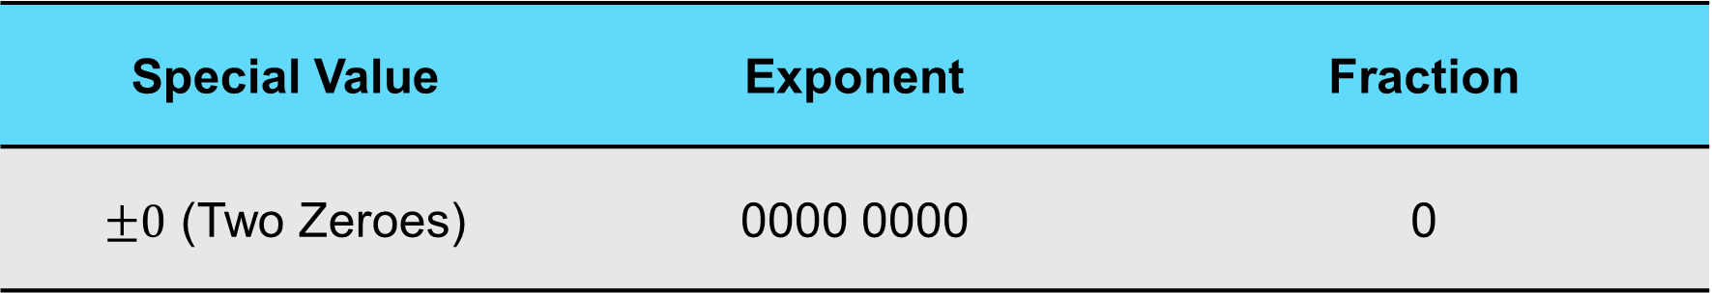
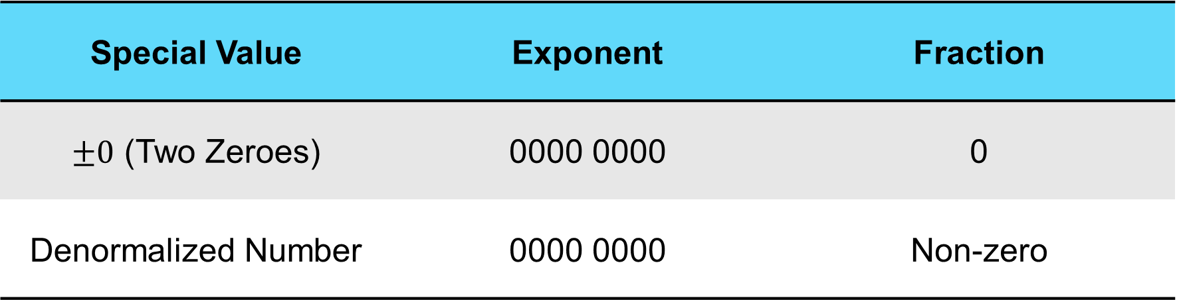
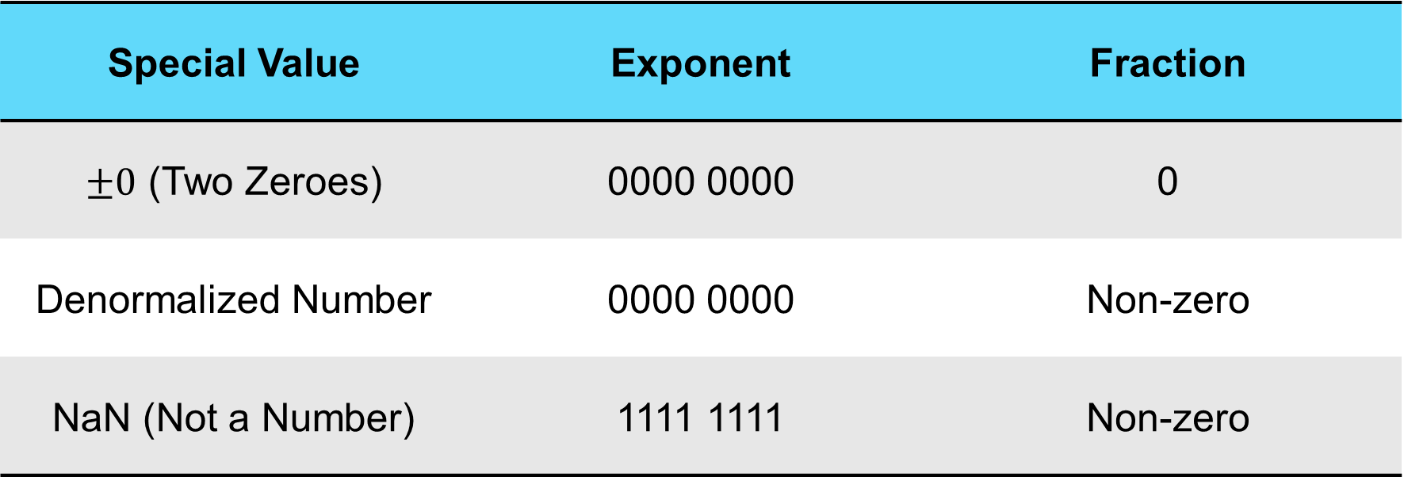
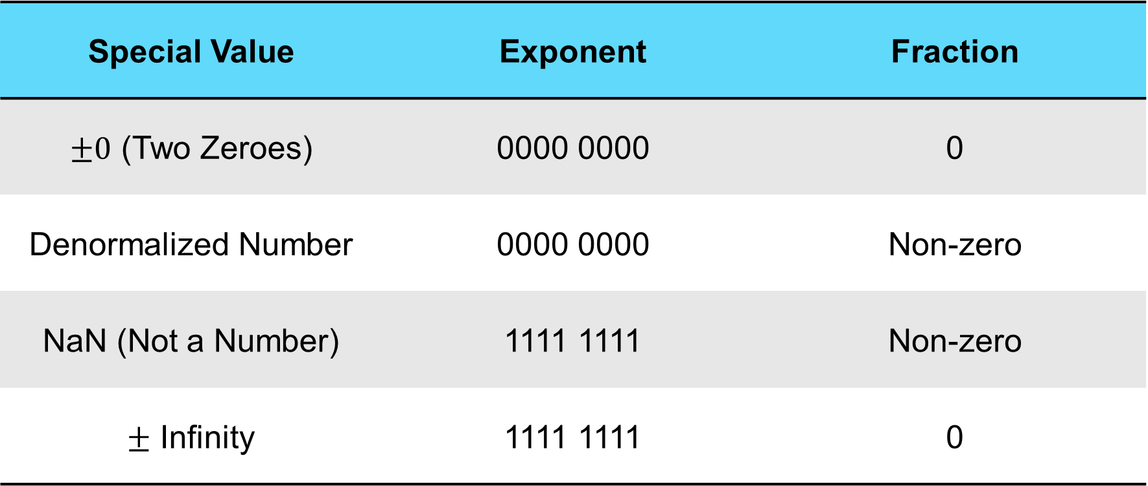
IEEE-754 Special Values
Special Value | Exponent | Fraction
$±0$ (Two Zeroes) | 0000 0000 | 0
Denormalized Number | 0000 0000 | Non-zero
NaN (Not a Number) | 1111 1111 | Non-zero
$±$ Infinity | 1111 1111 | 0
Special Value | Exponent | Fraction
$±0$ (Two Zeroes) | 0000 0000 | 0
Denormalized Number | 0000 0000 | Non-zero
NaN (Not a Number) | 1111 1111 | Non-zero
Special Value | Exponent | Fraction
$±0$ (Two Zeroes) | 0000 0000 | 0
Denormalized Number | 0000 0000 | Non-zero
Special Value | Exponent | Fraction
$±0$ (Two Zeroes) | 0000 0000 | 0
Special Value | Exponent | Fraction
Notes:
OFF SCREEN
Next we’ll go over special cases [CLICK]
first a 0 in the exponent
A zero in the exponent field and a zero in the fraction field means the number is zero.
The sign field can be 1 or 0, so there are two representations of zero. [CLICK]
If the exponent is zero and the fraction is non-zero,
that is called a denormalized number
In this case the number to the left of the binary point is assumed to be zero. [CLICK]
a 1 all ones in the exponent and a non-zero number in the fraction is not a number
That’s a “whoops”
it could overflow or underflow. It’s mostly just bad news.
back in the day i used to get printed output from mainframes and i can remember seeing NaNs and think ugh what does that even mean?
it meant I messed up the code. [CLICK]
all ones in the exponent and a zero in the fraction means infinity
[CLICK – Next Slide]

Slide 9
What number does 0xFF800000 represent if it is a IEEE 754 format floating point number?
1111 1111 1000 0000 0000 0000 0000 0000 1 11111111 00000000000000000000000
Sign 1 Exponent 255-127 = 128 Fraction 0 Negative Infinity

Slide 10
Express 0.0625 in IEEE 754 format hexadecimal
0.0625 = 1/16 = 1/2⁴
Binary = 0.0001
Normalize = 1.0 x 2⁻⁴
Sign = 0
Exponent = -4+127 = 123 = 01111011
Fraction = 0
0 01111011 00000000000000000000000
0011 1101 1000 0000 0000 0000 0000 0000
0x3D800000

